Slide 1
E224 – 2014 Results

Slide 2
Experimental Goals for 2014
Demonstrate the feasibility of detecting phase modulation of a probe pulse by a plasma at a single image plane in a low density (<1E17) plasma.

Slide 3
Results from 2014
Observation of plasma modulated probe pulse:
From laser ionized plasma
From beam ionized plasma
Development of an in-oven alignment technique
Observation of laser-heated plasma
Observation of plasma structure evolution over ps-ns-us time scale.

Slide 4
Probe Pulse Modulation
No Plasma
Observation of “bow-tie” pattern modulation of probe pulse by laser and e-beam ionized plasma.
Laser-Ionized Plasma
Beam-Ionized Plasma

Slide 5
“In-Oven” Alignment
Before Alignment
After Alignment
e-beam
axicon
We can simultaneously image the axicon focus and the location of the beam ionized plasma at a single z location. This image provides a new technique for aligning the axicon focus to the e-beam.

Slide 6
Laser-Heated Plasma
¼ Power
The diffraction pattern observed in the probe pulse becomes chaotic at high laser power. We used this diagnostic to optimize our laser power so that we are ionizing, but not heating the plasma.
½ Power
Full Power

Slide 7
Timing Studies
100 ps Delay
1 ns Delay
We varied the timing of the probe pulse with respect to electron beam arrival time and observed the expansion of the beam-ionized plasma channel.

Slide 8
Simulation Work
We are preforming optics calculations to model our system and compare observations with expected results for different plasma shapes.
Instead of simulating the whole large probe, the diffraction of a thin laser beam through the plasma is calculated with the Fresnel formula (near-fear diffraction), and integrated at multiple z locations.
The whole probe is recovered with a waterfall plot in z.
Z = +1
Z = 0
Z = -1
Light from the probe, seen as a sum of multiple fine ray
α
Plasma plane = diffracting object
Image plane

Slide 9
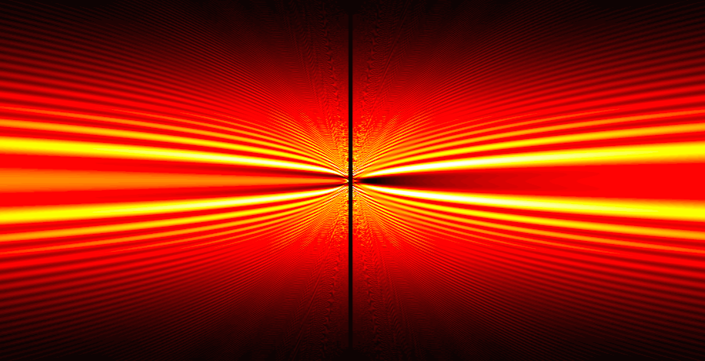
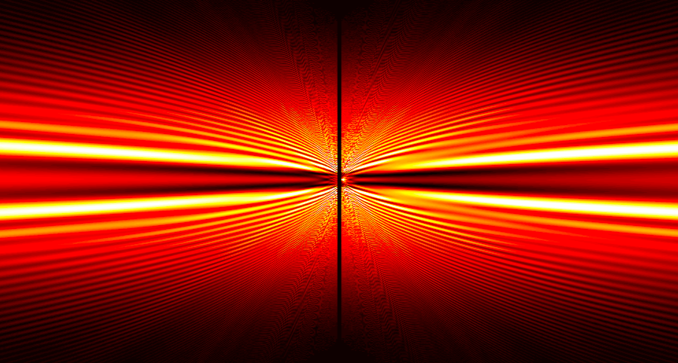
Simulation Work
On the left : Probe pulse diffraction observed from a beam-ionized plasma column.
Below : Simulation of Fresnel diffraction from a uniform cylinder of plasma. α = 1/100 rad
Plasma radius = 100E-6 m
Plasma radius = 200E-6 m

Slide 10
Experimental Setup for 2014 Diagrams and Images

Slide 11
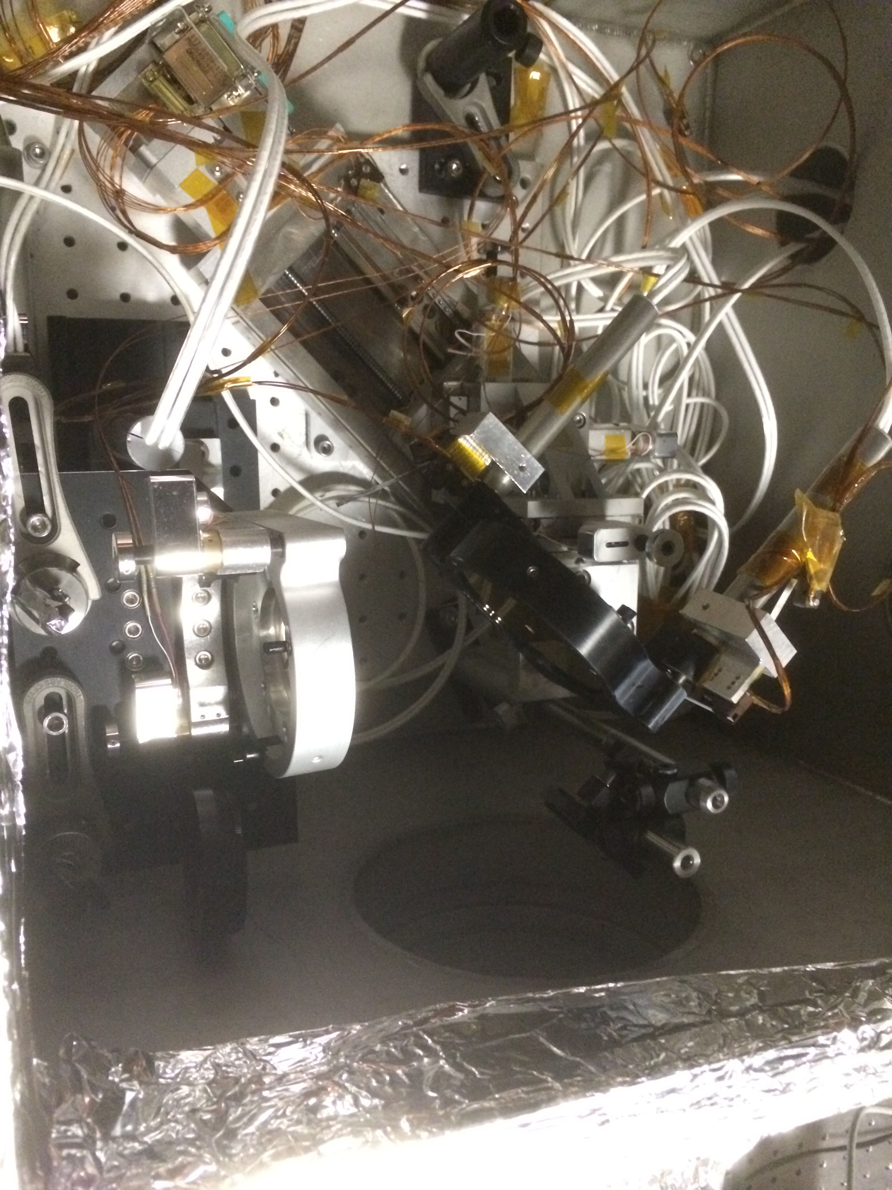
Pickoff System
Pickoff System
P3
Axicon
Waveplate
P1
P2

Slide 12
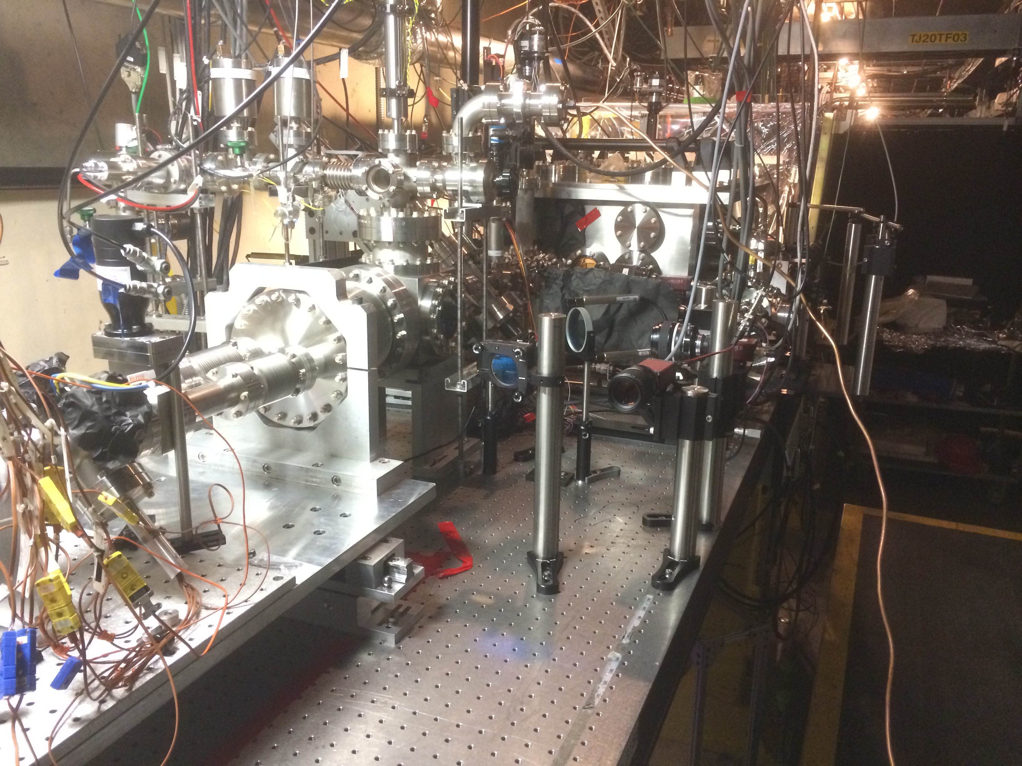
Output System
DS Gold Mirror
Motorized beam splitter
DS_GOLD GigE
1m lens
E224_Align GigE

Slide 13
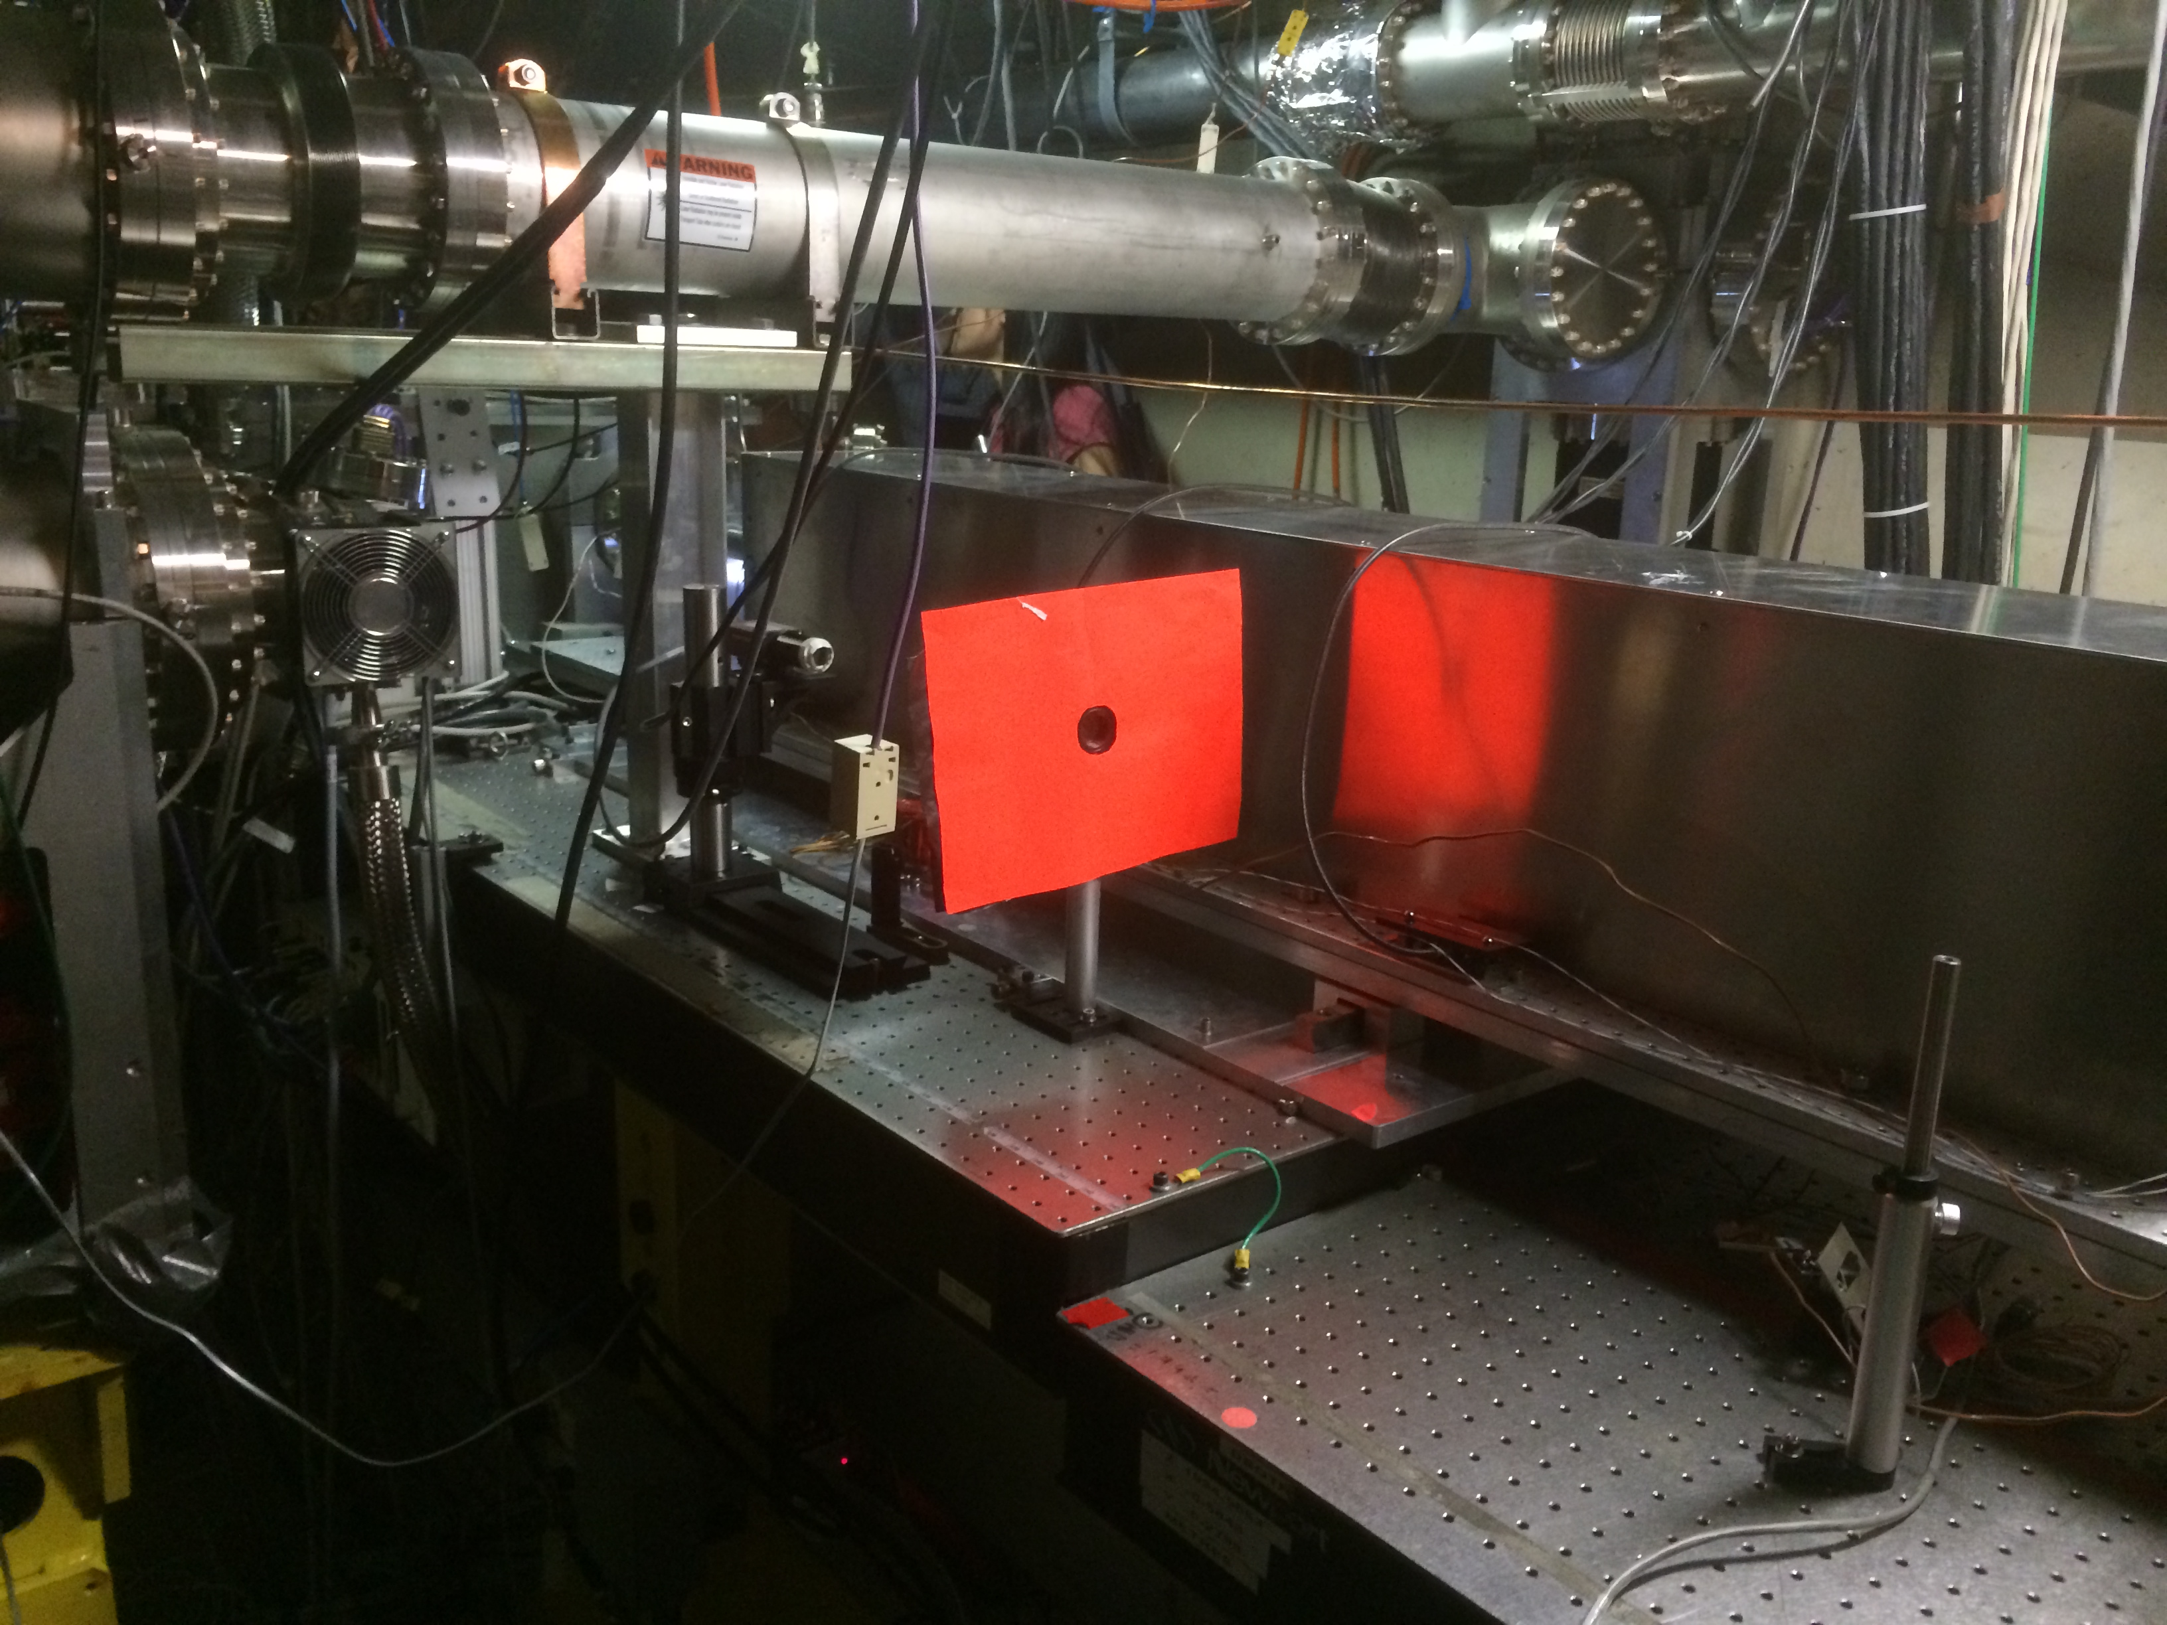
Output System
Image Plane
E224_Probe GigE with 800 nm interference filter
Alignment screen
Spatial Filter

Slide 14
E224 Simple Diagram
Image Point
IP Box
6” Cube
Plasma Volume
Axicon
λ/2
1 m Lens
Compressed Laser Pulse
CCD
Polarizer
Ionization Pulse
Probe Pulse

